Slide 1
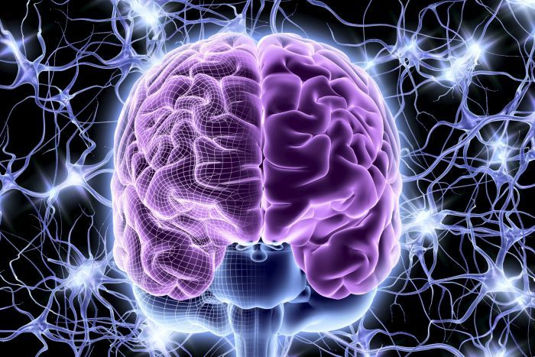
DAART
Introduction to
Neural Network
Ting Zhe 16th May 2016
Notes:
Neural Network is a powerful machine learning technique. All the cool stuff you see today such as driverless cars, or AlphaGo, the AI that beat the top player in Go, uses neural network.

Slide 2
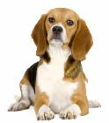
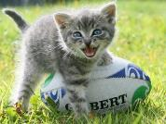



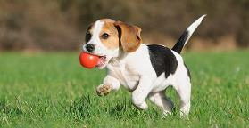


Artificial Neural Network
is a machine learning algorithm, that can train a model to predict things.
That’s a cat!
Dog!
Neural Network

Slide 3
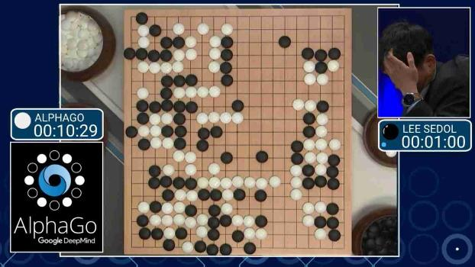
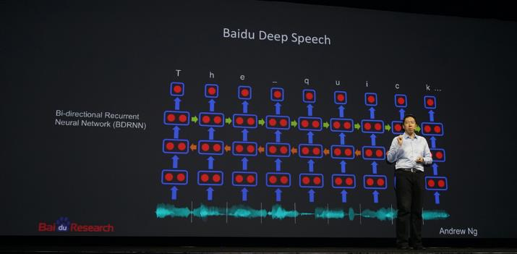
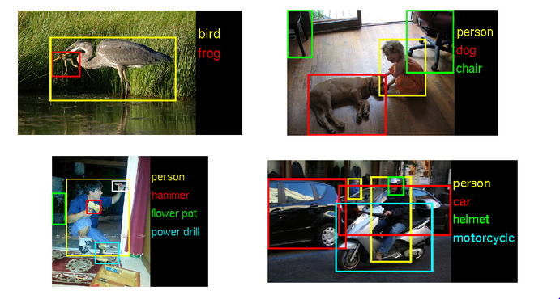
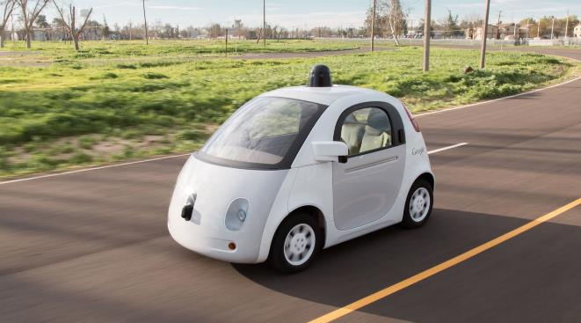

Slide 4

Notes:
This is a biological neural network. Our brain is made up of many neurons, connected together to form a network. Each neuron can only do simple task, but when they work together in a network, they can perform more complex task, such as facial recognition or storing memories.

Slide 5
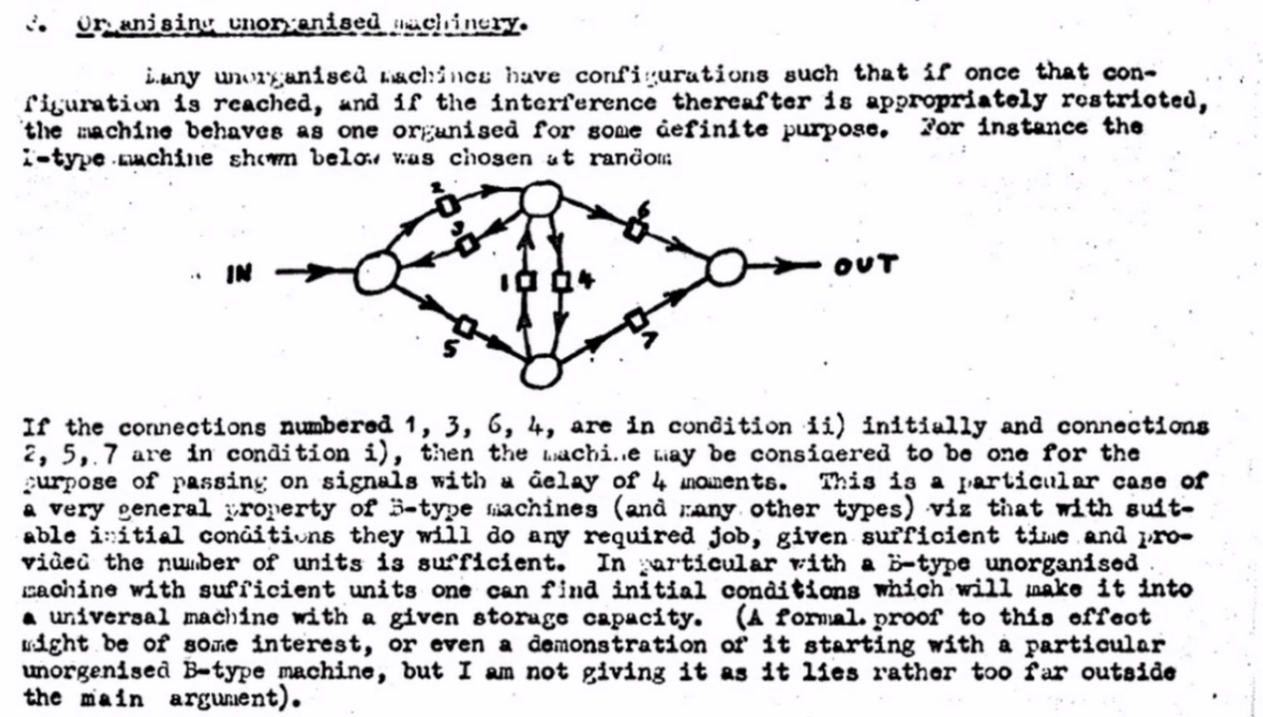
Notes:
As early as 1940s, people started thinking about brain as computers, and how it might work. For example, Alan Turing, considered to be the forefather of computer science, propose a computing architecture that you have very simple units like neurons, that will make very simple calculations based on connections from other nuerons, and the connections will be tunable. The machine will be unorganised, and through training, it'll organise itself to do the task at hand

Slide 6
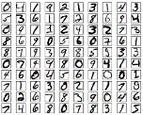

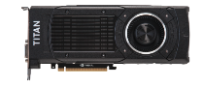
Neural Networks
2014 : Machine Translation
2012 : Computer Vision
1990’s
2009 : Speech Recognition
2010’s
DEEP
LEARNING
1980’s
2000’s
...which utilises neural networks
Why is Neural Network suddenly so popular now?
Huge amounts of Data
Cheaper GPUs
Notes:
So, people started building these machines, and they worked kinda okay. However, for most of the 20th century , expert system & rule based system were better at solving.complicated problems. But in the last 5-10 years, incredible revival of NN. Be it in image recognition or speech translation. Part of it is because of better algorithm and alot more access to big data, but the biggest reason is because of cheap parallel computation.

Slide 7
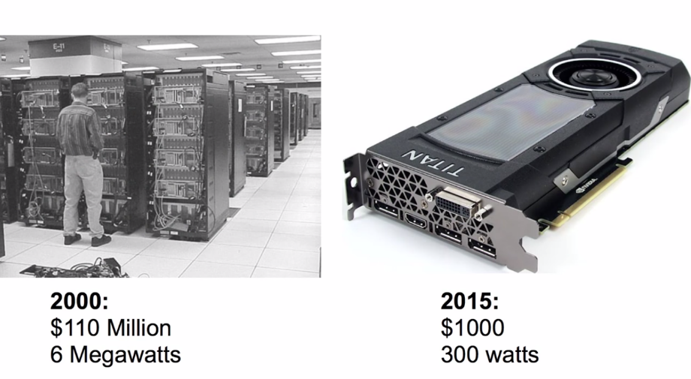
Notes:
To give you some comparison, in 2000 the fastest computer in the world was a building. Cost $x and consume x megawatts. 15 years later, you can buy a GPU which produce the same amount of computational power as that for $1000, and it is this big, and you can put in on your desktop.

Slide 8
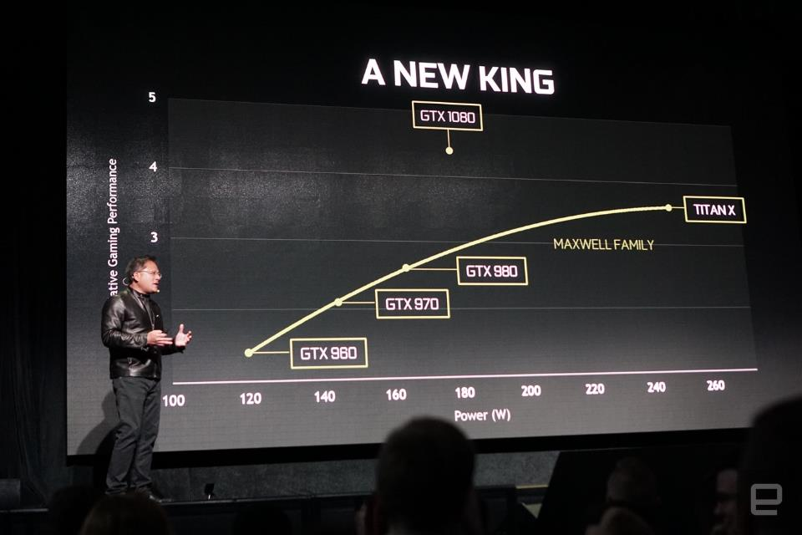

Slide 9
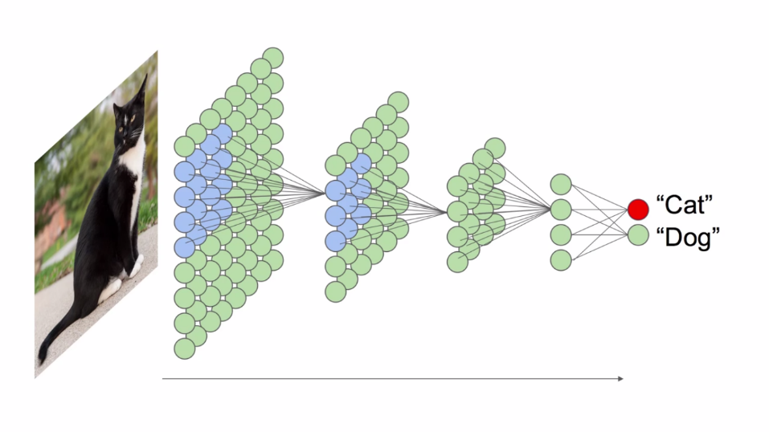
Notes:
They're composed of simple units. Each unit does a very simple calculation like an addition or a simple function. It takes input from many other neurons, combine them together, and send it downstream to other neurons. These things are connected in a kind of network.
We need to train the network. This kind of machines are capable of extracting important features from any kind of input data. We're show the network thousands and thousands of cat and dog photo, and each time we'll tell the network this is a cat this is a dog. If it gives a wrong answer, which it'll do all the time in the beginning, we adjust the weights of the network such that it'll answer more correctly. if we do this over and over again, we end up with a computer program that can distinguish pictures of cats and dogs even in cases where they have never seen the picture before. That's the point. It generalises what makes a cat, and what makes a dog.

Slide 10
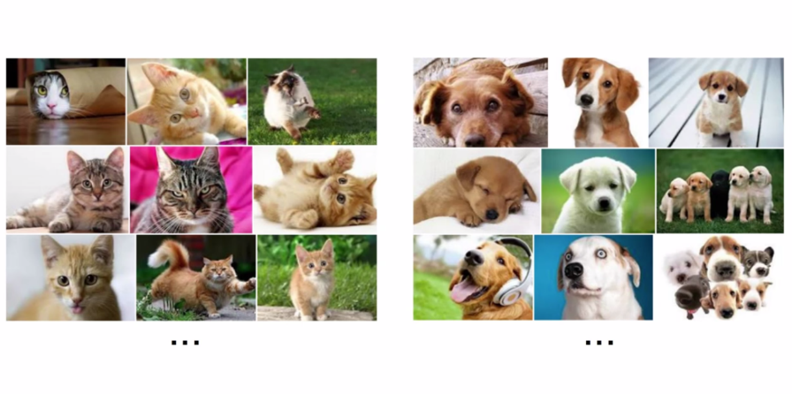

Slide 11
Notes:
They're composed of simple units. Each unit does a very simple calculation like an addition or a simple function. It takes input from many other neurons, combine them together, and send it downstream to other neurons. These things are connected in a kind of network.
We need to train the network. This kind of machines are capable of extracting important features from any kind of input data. We're show the network thousands and thousands of cat and dog photo, and each time we'll tell the network this is a cat this is a dog. If it gives a wrong answer, which it'll do all the time in the beginning, we adjust the weights of the network such that it'll answer more correctly. if we do this over and over again, we end up with a computer program that can distinguish pictures of cats and dogs even in cases where they have never seen the picture before. That's the point. It generalises what makes a cat, and what makes a dog.

Slide 12
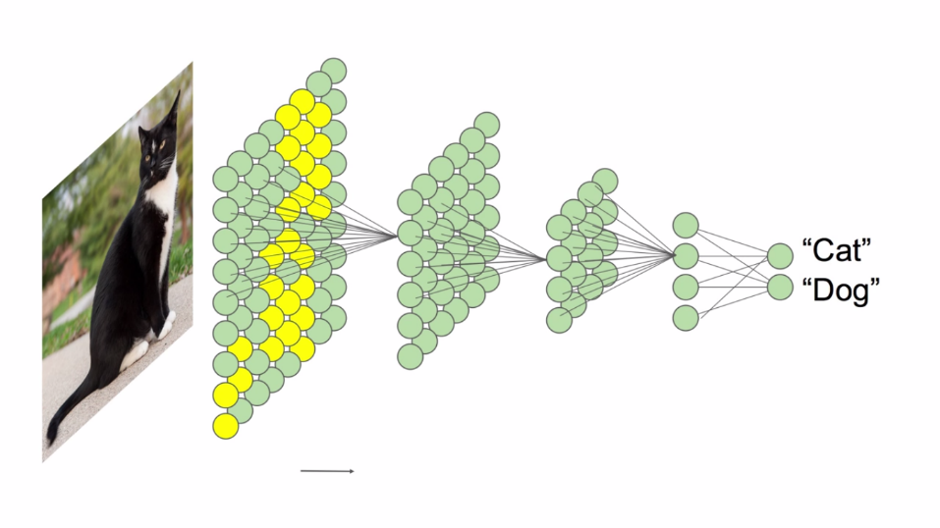
Notes:
It self organise in such a way that layers that are close to the input data become reactive to simpler features, like edges, and corners. As you move through the layers, the features become higher and higher order. For example they can recognise shapes like squares, eye. Similar to our own brain.

Slide 13
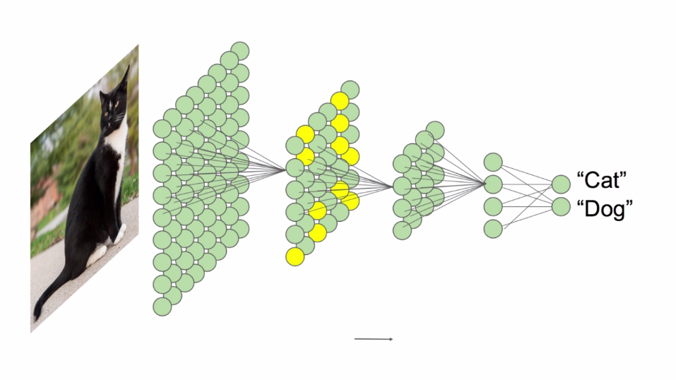

Slide 14
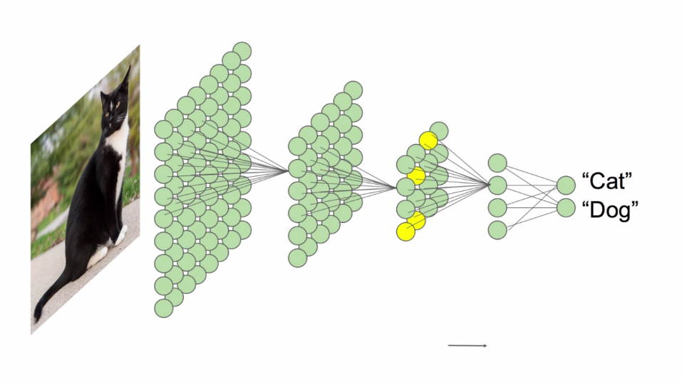

Slide 15
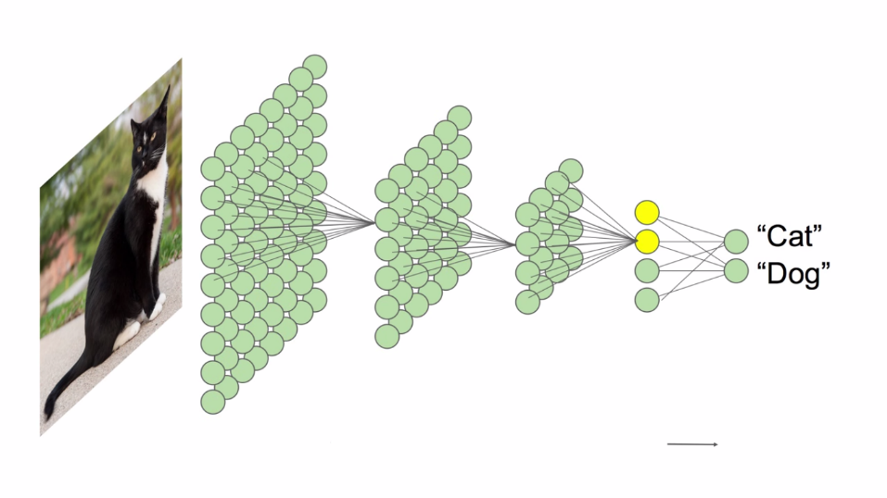

Slide 16
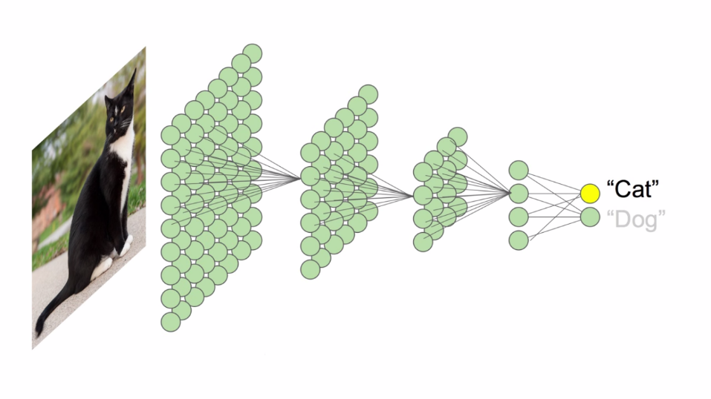

Slide 17

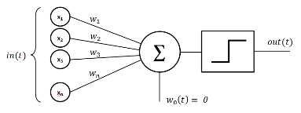
Perceptron
Neuron
In our brain
Perceptron In Artificial Neural Network
Notes:
A perceptron is an artificial representation of a neuron, similar in function to neurons in the brain

Slide 18
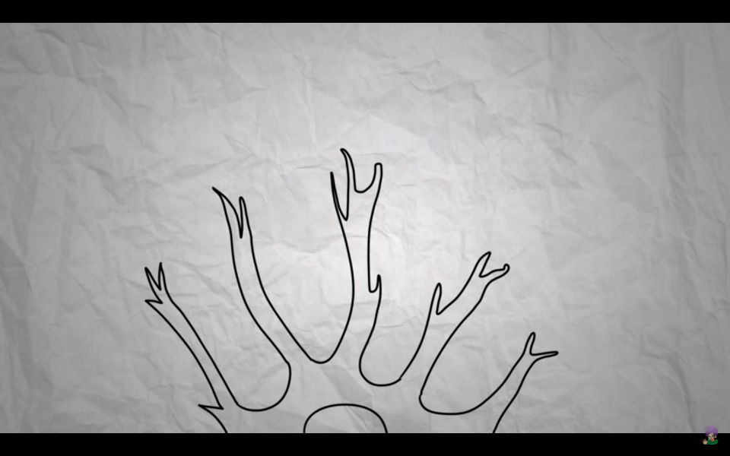
Notes:
In an actual brain, neurons receive information from the outside world through the five senses and encode this into electrical signals. These signals are fed as input into some of these neurons, like input into a program. If the electrical input breaks the neuron's internal threshold, the neuron will fire, sending signals to other neurons. Researchers designed the perceptron to emulate this behavior. In a perceptron, we have several inputs, a threshold function, and several outputs. These inputs are binary, in that they can either be on or off, and they're weighted based on their relative importance. When the perceptron receives input, it sums up the weights of all the inputs that are on. If this sum exceeds the pre-specified threshold, then the perceptron will "fire" by activating its outputs.

Slide 19
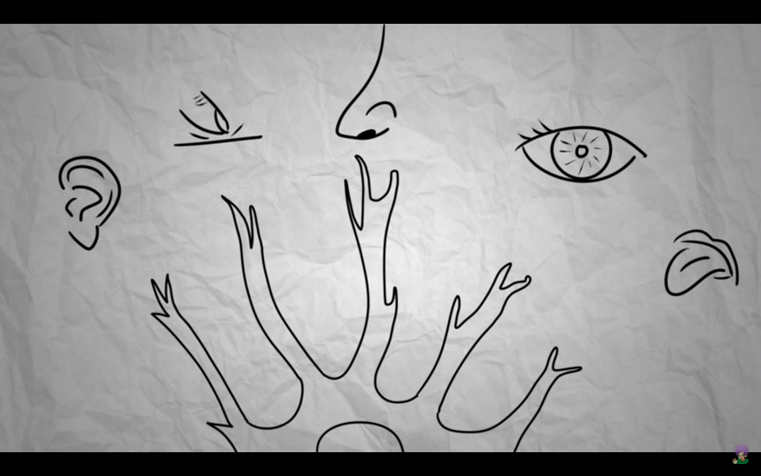

Slide 20
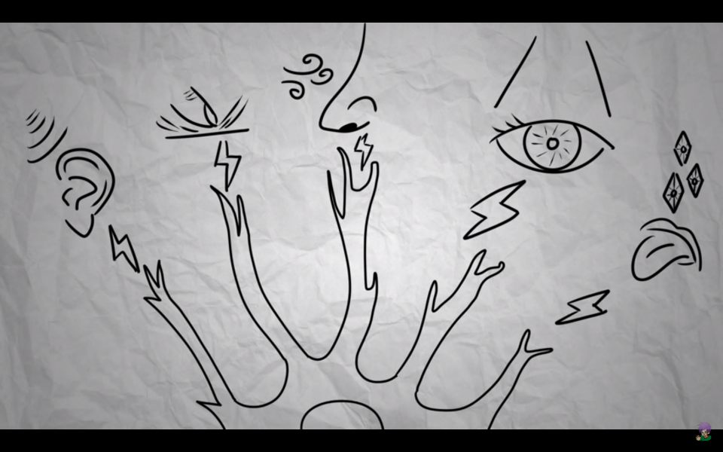

Slide 21
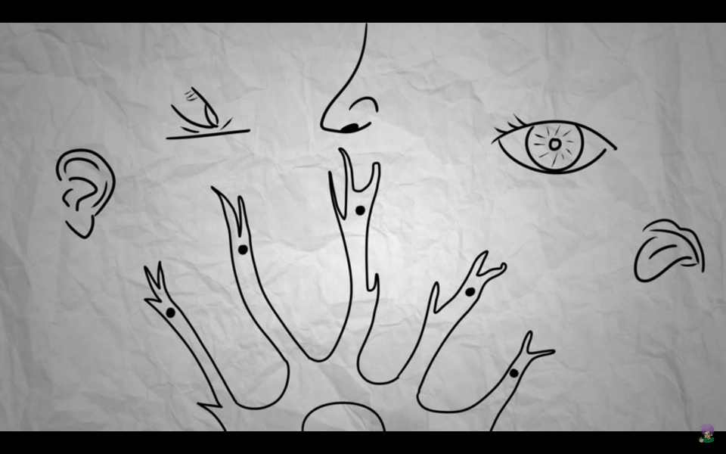

Slide 22


Slide 23
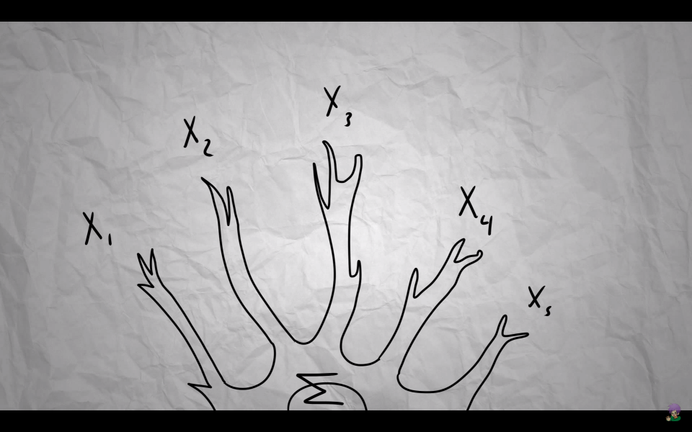

Slide 24
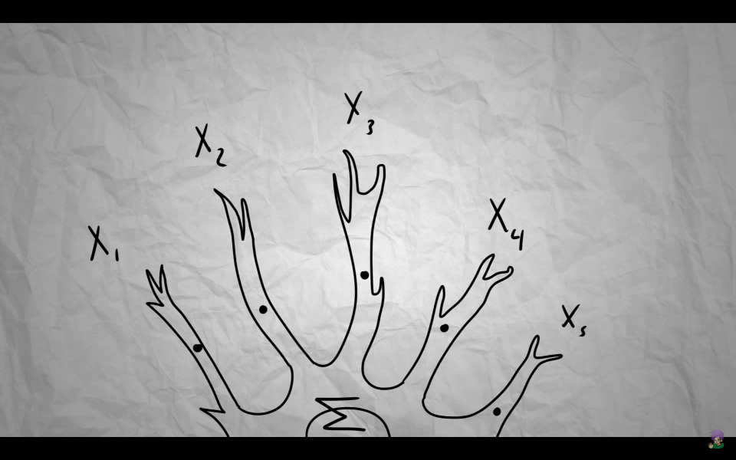

Slide 25


Slide 26
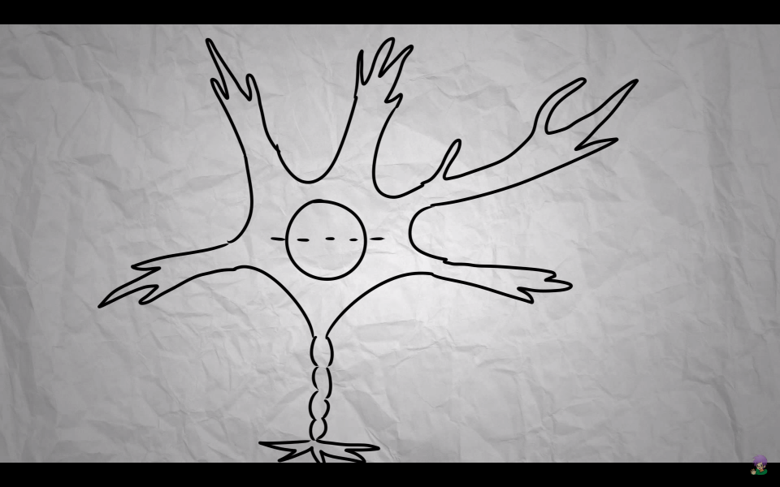

Slide 27
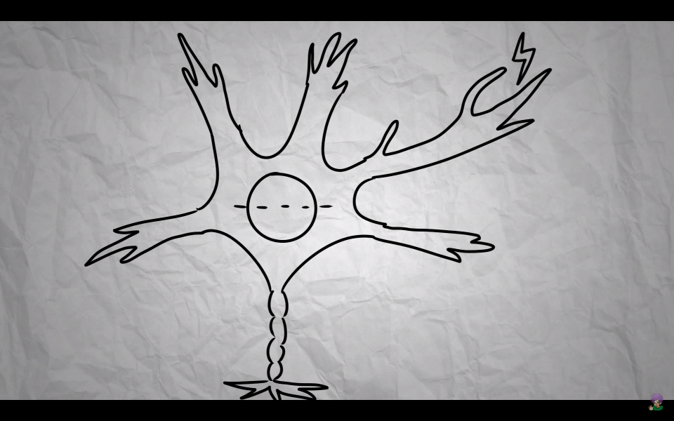

Slide 28
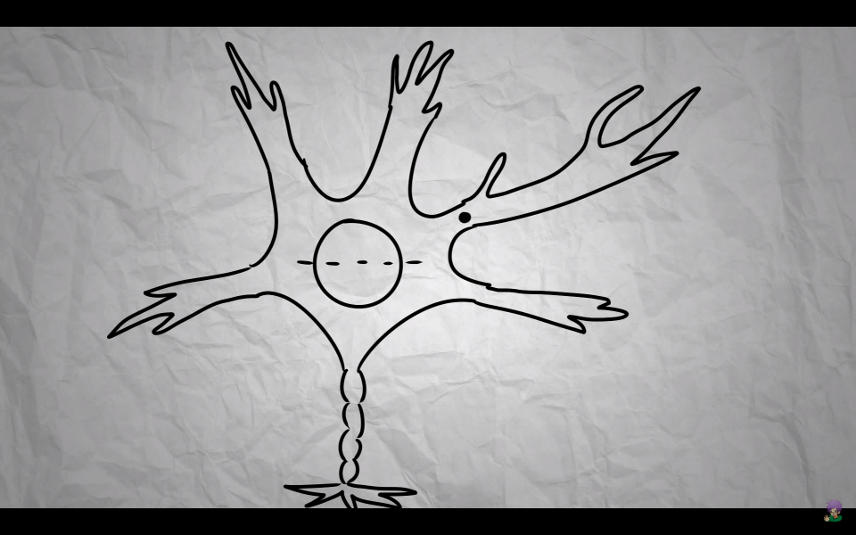

Slide 29


Slide 30
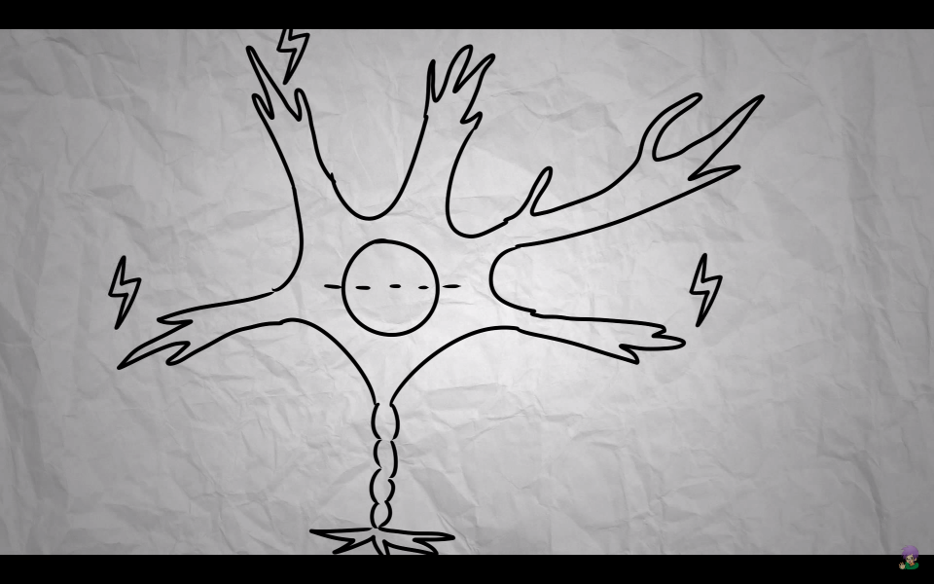

Slide 31
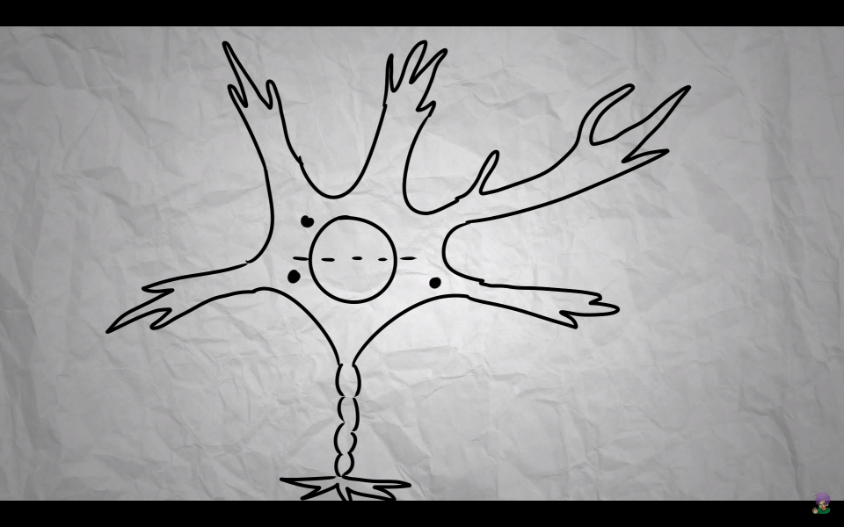

Slide 32


Slide 33
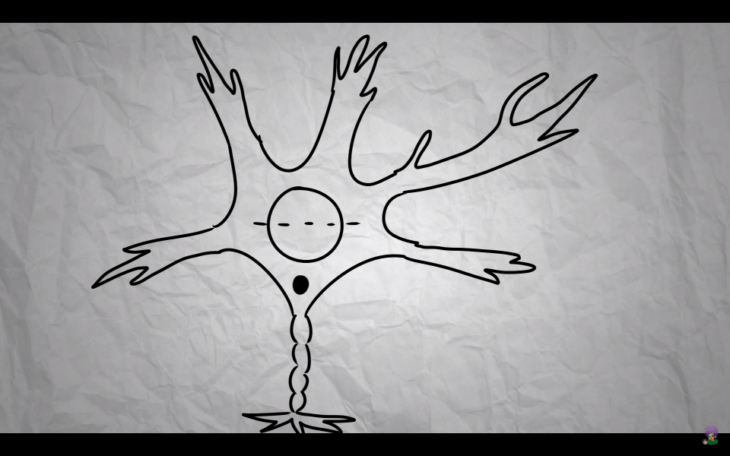

Slide 34
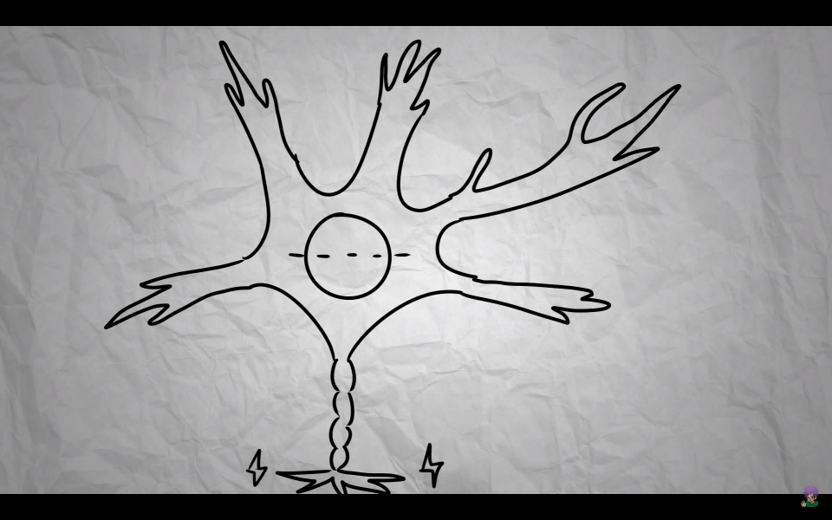

Slide 35
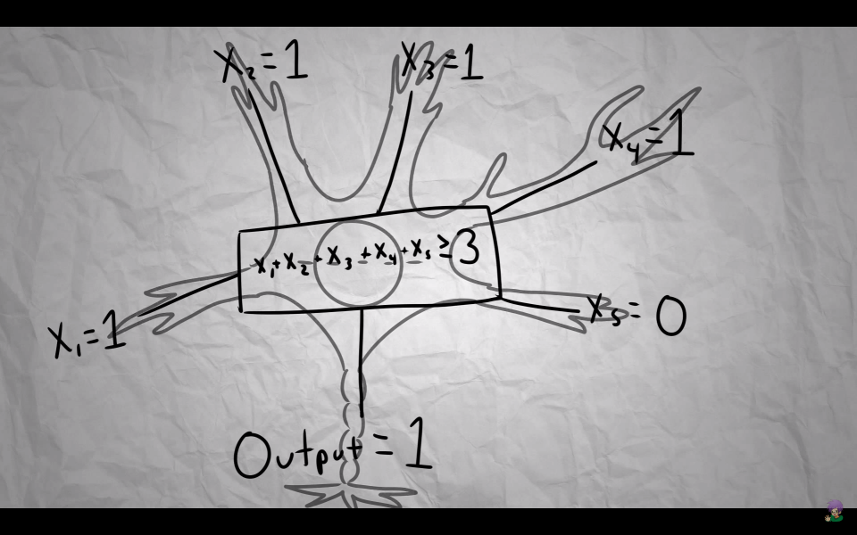

Slide 36
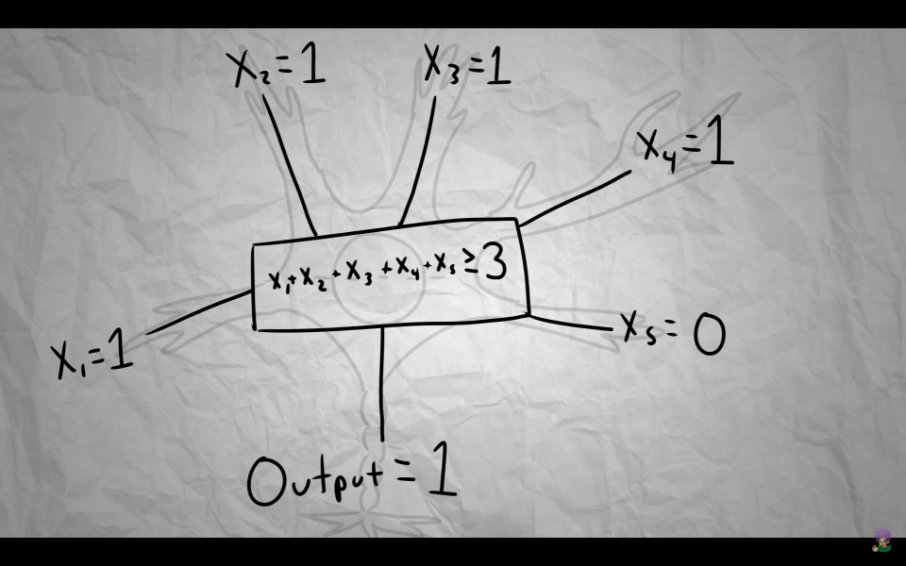

Slide 37
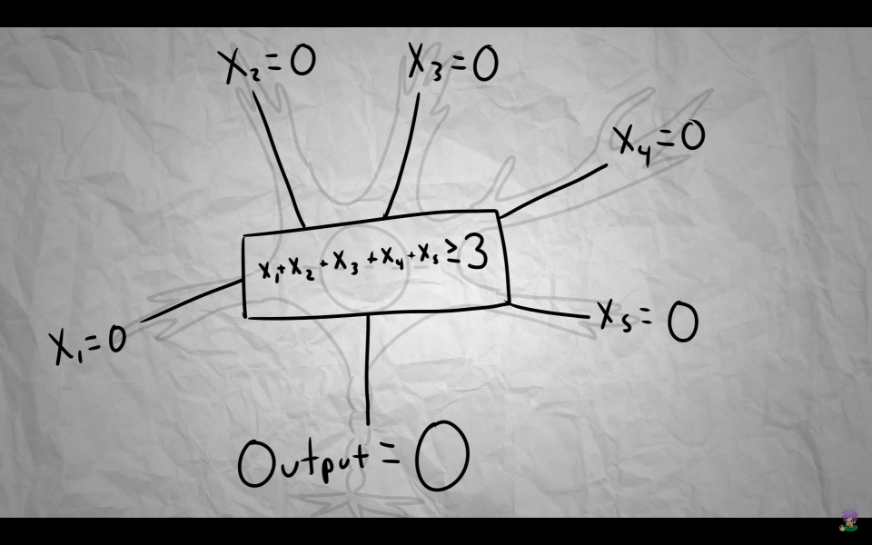

Slide 38


Slide 39


Slide 40
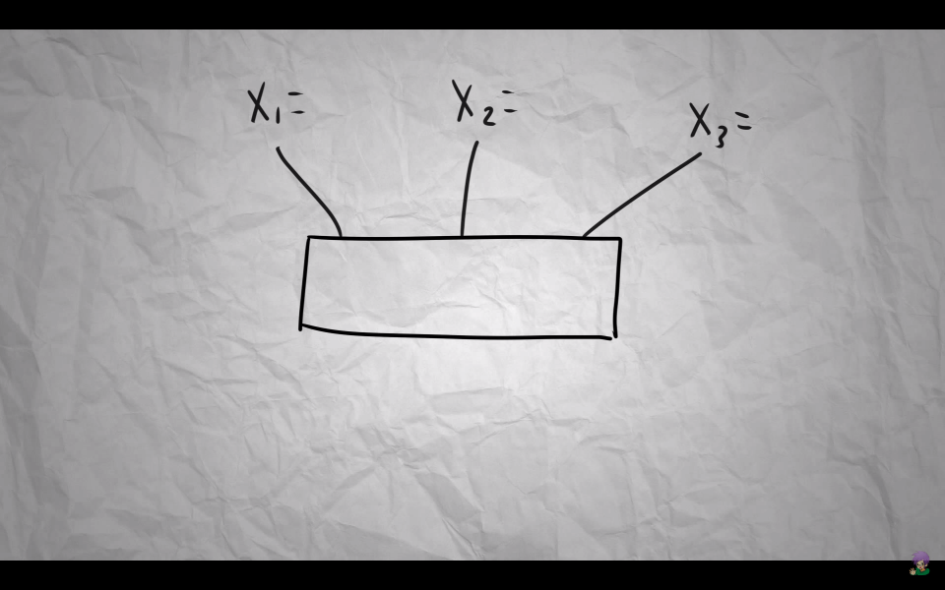

Slide 41
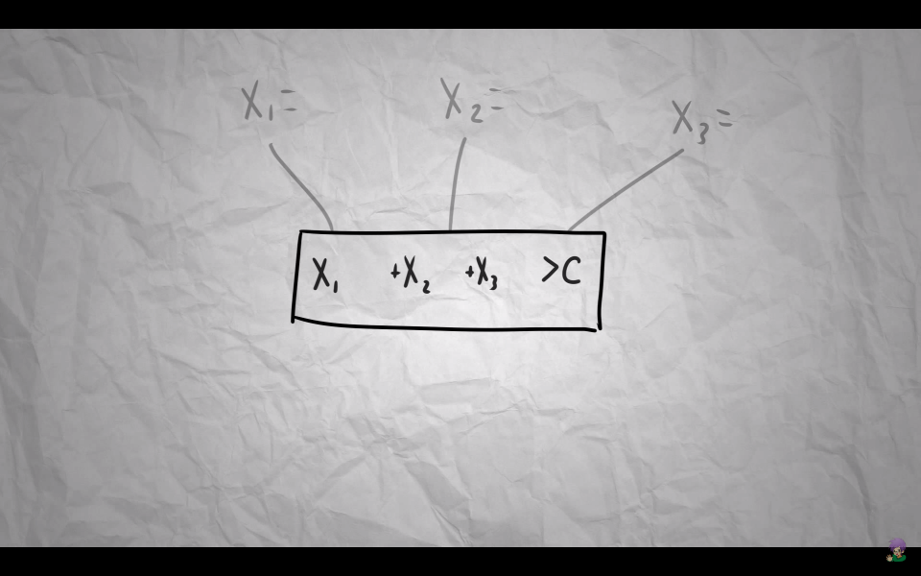

Slide 42
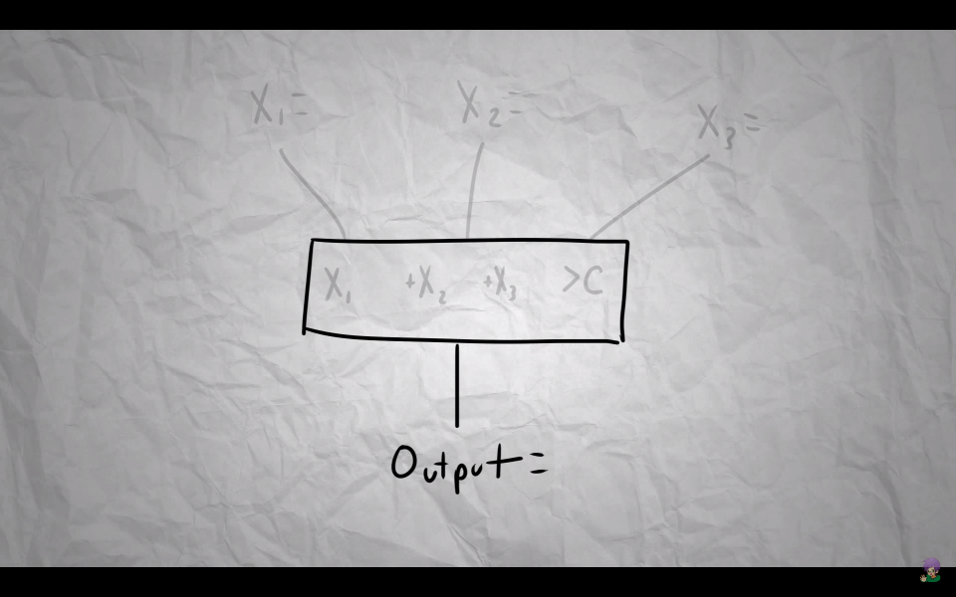

Slide 43
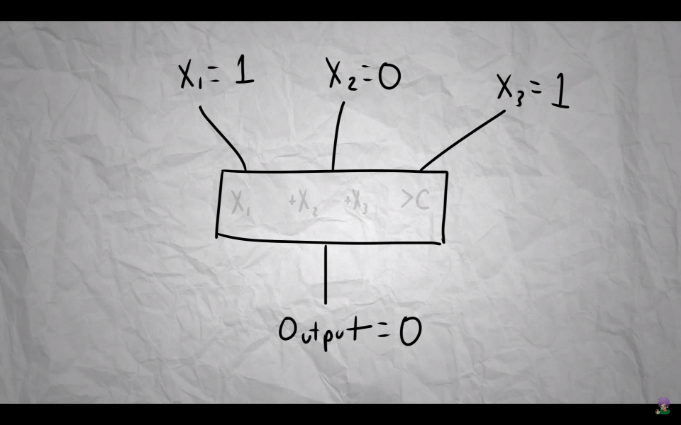

Slide 44
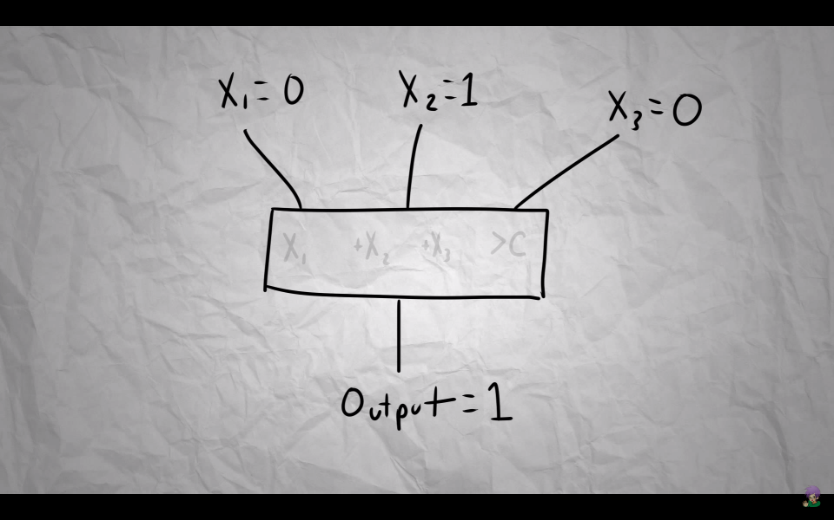

Slide 45
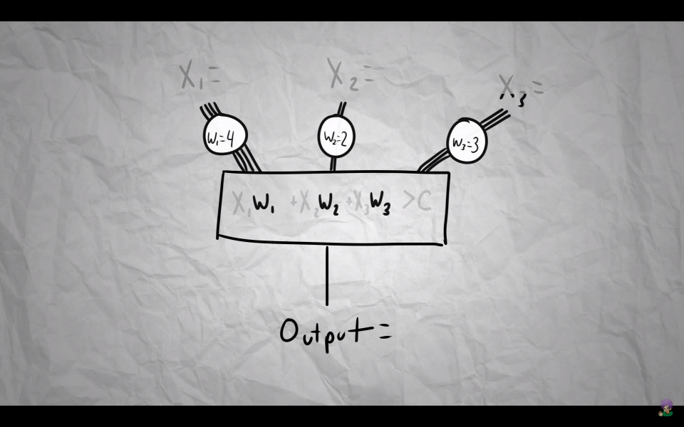

Slide 46
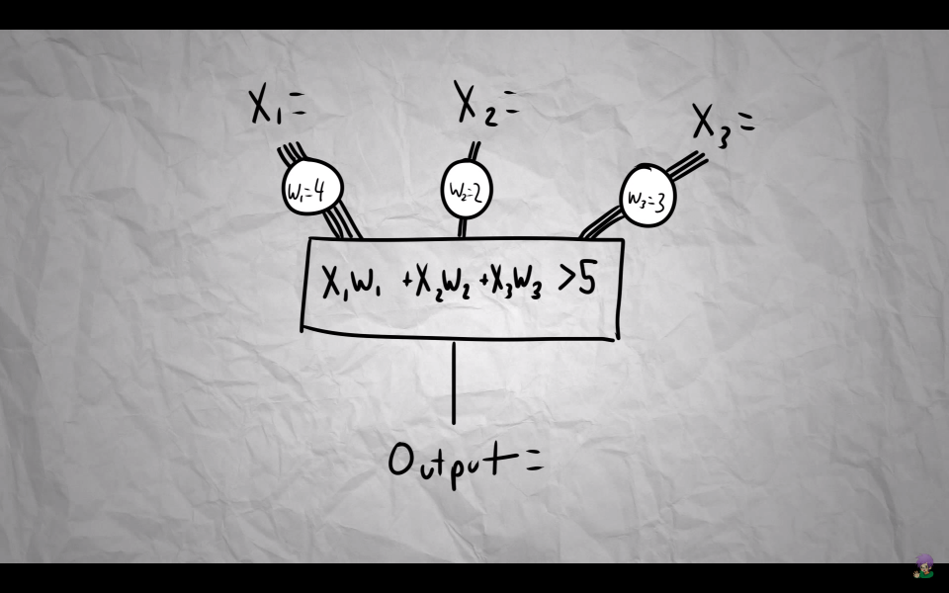

Slide 47
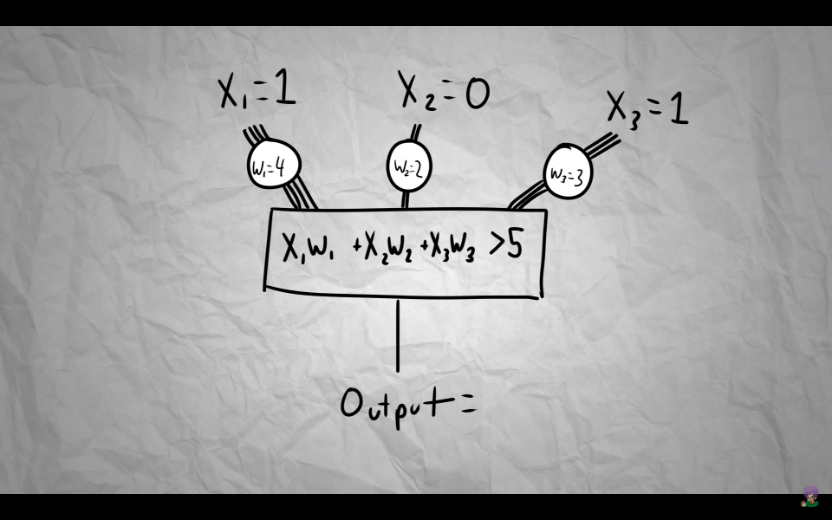

Slide 48
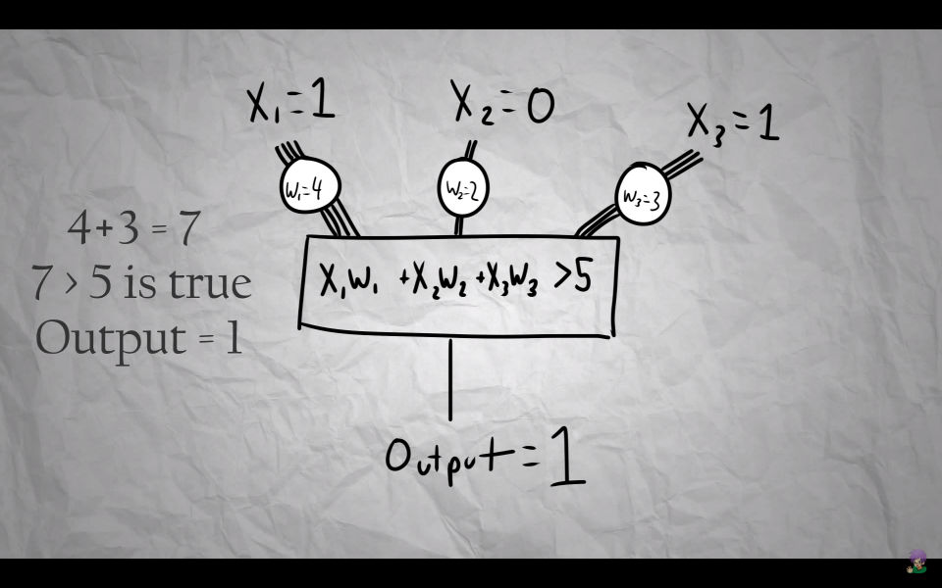

Slide 49
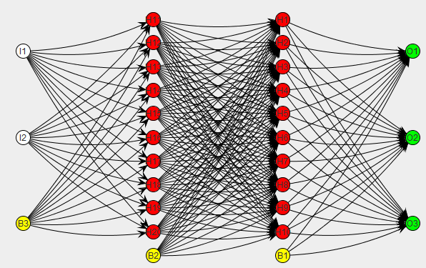
Notes:
The neuron itself is rather simple, so where does the vast complexity of the brain come from? How, from this simple act of firing, can we get emotion, personality, even consciousness? It's in the way the neurons themselves are connected. The brain is made up of 100 billion neurons and over 1000 trillion connections, and these connections are constantly changing. The ability of the brain to change its own structure allows a person to learn, create memories, and change the way they act in the future. And so, to achieve this kind of complexity with perceptrons, we connect them together. Most of the time, the perceptron's outputs feed into another perceptron's input, thus modeling the interconnectedness of neurons in the brain. And, just like the brain learns by altering the connections between neurons, we can simulate learning in a computer by modifying the connections between the perceptrons based on whether it reaches its specified goal state.

Slide 50

Adjusting Weights during Training
Dog
Cat
-1
0
1
5
-2
-9
3
-0.8 DOG
4
1
Training
Data
1
0.5
-2
Input
Output
Notes:
Adjusting Weights

Slide 51
Adjusting Weights during Training
Dog
Cat
-1
0
1
4
-2.5
-9
3.5
-0.4 DOG
5
1.2
Training
Data
-1
6
-3
Input
Output
Notes:
Adjusting Weights

Slide 52
Adjusting Weights during Training
Dog
Cat
-1
0
1
5
-2.8
-11
3.7
0.3 CAT
4
1.5
Training
Data
-3
7
-4
Input
Output
Notes:
Adjusting Weights

Slide 53
Adjusting Weights during Training
Dog
Cat
-1
0
1
5.5
--3
-11.3
3.9
0.9 CAT
5
1.5
Training
Data
-3.2
7
-7
Input
Output
Notes:
Adjusting Weights

Slide 54
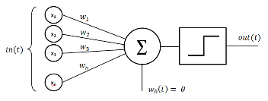
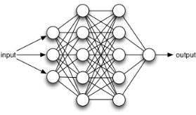
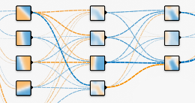
Recap on Artificial Neural Network
1
Perceptron is a simple representation of our neurons
The vast complexity of ANN comes from the connections between perceptron
2
3
The weights of ANN determines how a network ‘make decision’
Notes:
Recap

Slide 55



Slide 56
Neural Network in your browser
http://playground.tensorflow.org/

Slide 57
Quadcopter Navigation in the Forest using Deep Neural Networks
https://www.youtube.com/watch?v=umRdt3zGgpU

Slide 58
Neural Network plays Super Mario
https://www.youtube.com/watch?v=qv6UVOQ0F44

Slide 59


Slide 60


Slide 61
DAART
Thank You
Questions?

